Slide 1



PET vs MRI: Associations of Brain-Predicted Age and Risk of Alzheimer’s Disease Depend on Disease Stage and Modality
Doering E, Antonopoulos G, Hoenig MC, van Eimeren T, Eickhoff S, Patil K, Drzezga A
Presentation of Final Results for Submission at Frontiers of Aging Neuroscience

Slide 2
Recap: Presentation 12/17/2021
Methodological vs clinical paper?
Clinical
E.g. Frontiers in Aging Neuroscience (IF = 4.504), Neurobiology of Aging (IF = 4.673), NeuroImage (IF = 6.556)
Verification of results with different train-test splits
Double-checking of code
✓
✓

Slide 3
Research aims
Compare precision of brain-predicted age using MRI and FDG-PET in cognitively normal individuals (CN).
Compare association of MRI and FDG-PET-BPAD with cognitive function, neuropathology and cognitive decline in CN
Compare association of MRI and FDG-PET-BPAD with cognitive function, neuropathology and cognitive decline in individuals with mild cognitive impairment (MCI).
Notes:
This constitutes the basis for the current project.
Our first research aim was to compare the precision of brain-predicted age using MRI and FDG-PET in cognitively normal individuals.
The second aim was to compare associations of MRI and FDG-PET-BPAD with cognitive function, neuropathology and risk of cognitive decline in CN.

Slide 4



Participants
Table 1. Overview of samples
 | CN | CN_validation | MCI
n total | 379 | 59 | 621
Age [avg. years] | 74 | 72 (PET)/70 (MRI) | 73
Sex (F/M) | 196/183 | 35/24 | 264/355
MMSE [avg. score] | 29 | 29 | 28
Education [avg. years] | 16 | 16 | 16
Notes:
To give you a brief overview of our participants, they were all around the same age, on average between 70 and 74. More females were in the cognitively normal samples, whereas the MCI sample comprised more males.
AGE RANGE XX/SD

Slide 5
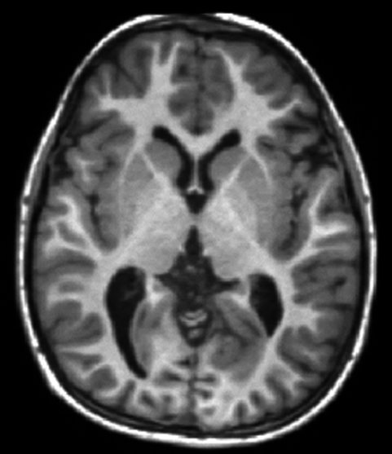

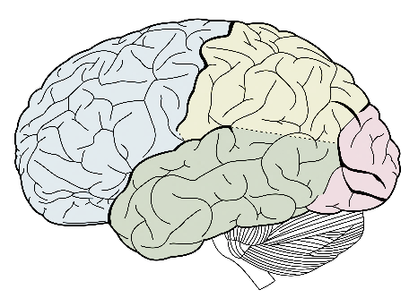
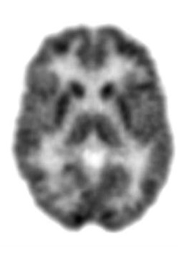
Pre-Processing
Mean gray matter volume (CAT)
MRI
2
216
Standardized uptake value ratio (SPM12)
FDG-PET
216 cortical and subcortical brain regions
2 models (SVR & RVR) with 3 tunable parameters (kernel, degree, C) each

Slide 6
Five Models
Training Sample
One test prediction for each CN subject
Test Sample
Model 1: One test prediction for each subject in CN_validation and MCI sample
Notes:
In order to obtain one independent test prediction for each individual in the sample of cognitively normal individuals, we repeated the process of train-test splitting five times in the form of a stratified five-fold cross-validation.
Since neither the OASIS validation, nor the MCI sample were included in the train-test splitting, each of the five resulting models provided a prediction for these samples. Throughout this presentation, I will show you the predictions of the first model.

Slide 7
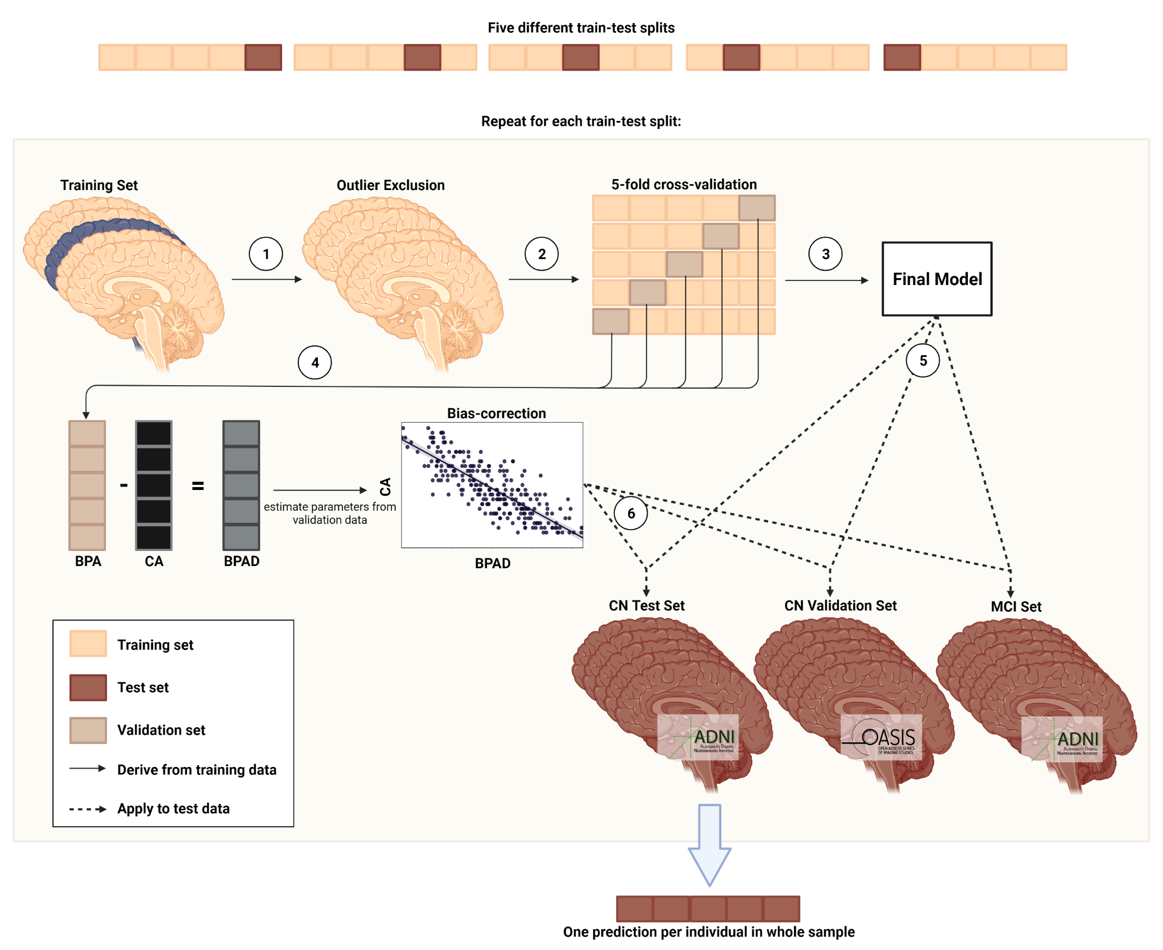
Figure 1. Pipeline for brain age prediction using nested cross-validation. (1) Outliers are excluded from the training set. (2) Training data is divided into five training/validation folds. (3) Cross-validation yields the final model for brain age prediction. (4) BPAD is used for bias correction. (5) Final model is used to yield predictions for test sets. (6) Bias-correction parameters are applied to test sets. BPA = brain-predicted age; CA = chronological age, BPAD = brain-predicted age difference.

Slide 8
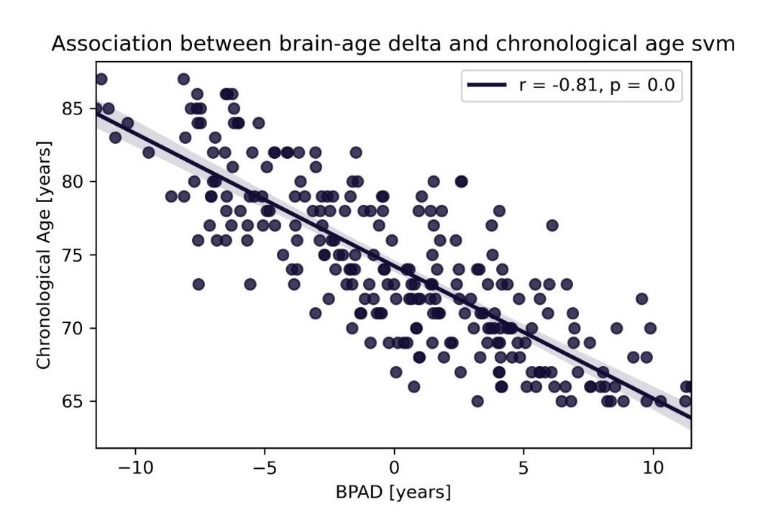
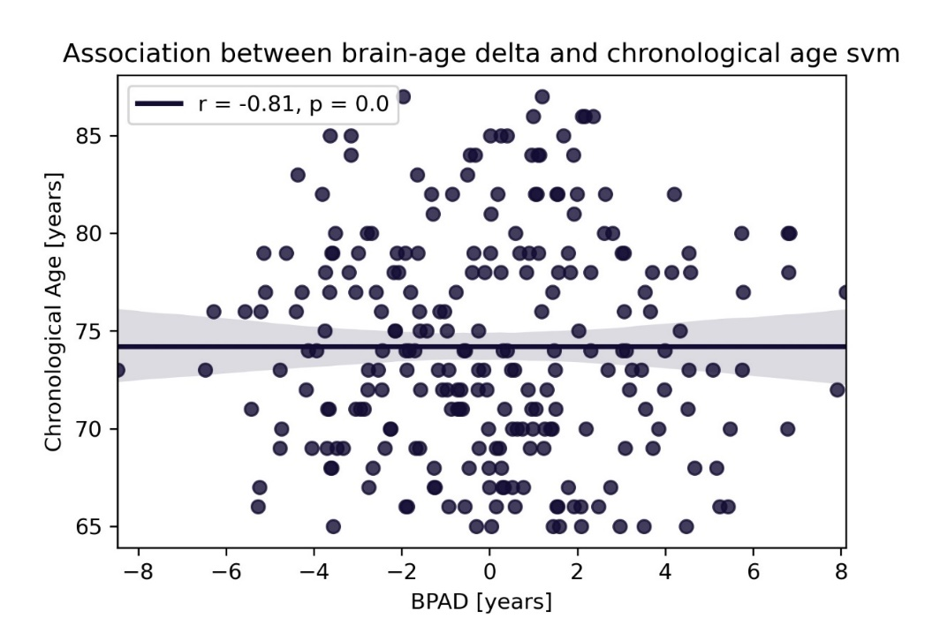
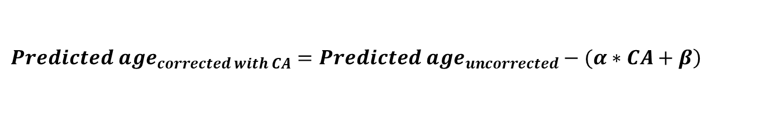
Bias Correction
$$\left.{Predicted age}_{corrected with CA}={Predicted age}_{uncorrected}−(α∗CA+β\right)$$
α = slope; β = intercept from linear model of CA X BPAD
PET
0, p = 1.0
Notes:
It is a very commonly observed phenomenon in brain age prediction that younger individuals are predicted to be older, while older individuals are predicted to be younger, as you can see in the left graph on this slide. This bias was corrected for by creating a linear model of chronological age and BPAD, and subsequently subtracting the inferred parameters from the predicted age.

Slide 9
Precision in brain age prediction is comparable across FDG and MRI
Table 2. Precision of predicting chronological age from FDG-PET and MRI scans. For CN_validation and MCI, results of the first model and metrics over all five models are shown.
 | CN |  | CN_validation |  | MCI
 | FDG | MRI | FDG | MRI | FDG | MRI
n total | 345⁺ | 345⁺ | 59⁺ | 59⁺ | 621 | 621
MAE | 1.99 | 1.89 | 1.83 | 2.42 | 1.94 | 2.66
MAE before bias correction | 4.04 | 3.97
Mean (SD) over 5 models | - | - | 2.04 (0.30) | 2.45 (0.19) | 2.17 (0.44) | 2.57 (0.11)
Mean difference | -0.10 | -0.05 | -0.80 | -0.80 | 0.78 | 1.15
Mean (SD) over 5 models | - | - | -0.66 (0.41) | -0.92 (0.16) | 0.67 (0.21) | 1.42 (0.16)
Notes. *After outlier exclusion using CN train set (IQR > 6)
Best model was SVR in 5/5 train-test splits for FDG-PET and MRI.
Notes:
Here I present you results for the comparison between FDG-PET and MRI in brain age prediction.
As we can appreciate from the mean absolute error, or MAE, in the CN sample, the precision of brain age prediction was largely similar between FDG-PET and MRI. The age of cognitively normal individuals was on average underestimated by -0.1 and 0.05 years in the two modalities. This shows that our predictions were very precise.
In the CN_validation sample, FDG-PET did a slightly better job in predicting brain age, as both the mean absolute error and the mean difference were smaller in this modality.
In the MCI group, we found that individuals were estimated older than their actual chronological age by 0.67 and 1.42 years for FDG-PET and MRI, respectively. So we found a bigger difference between chronological and predicted age in the MCI population when using MRI.

Slide 10
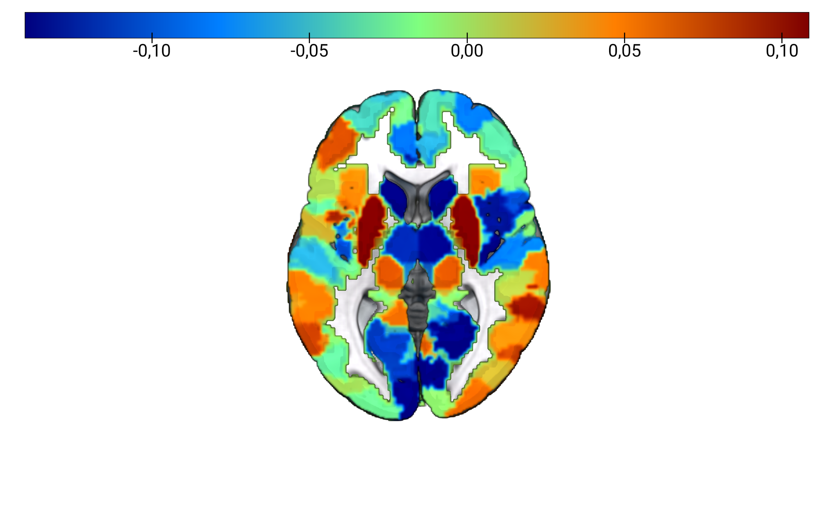
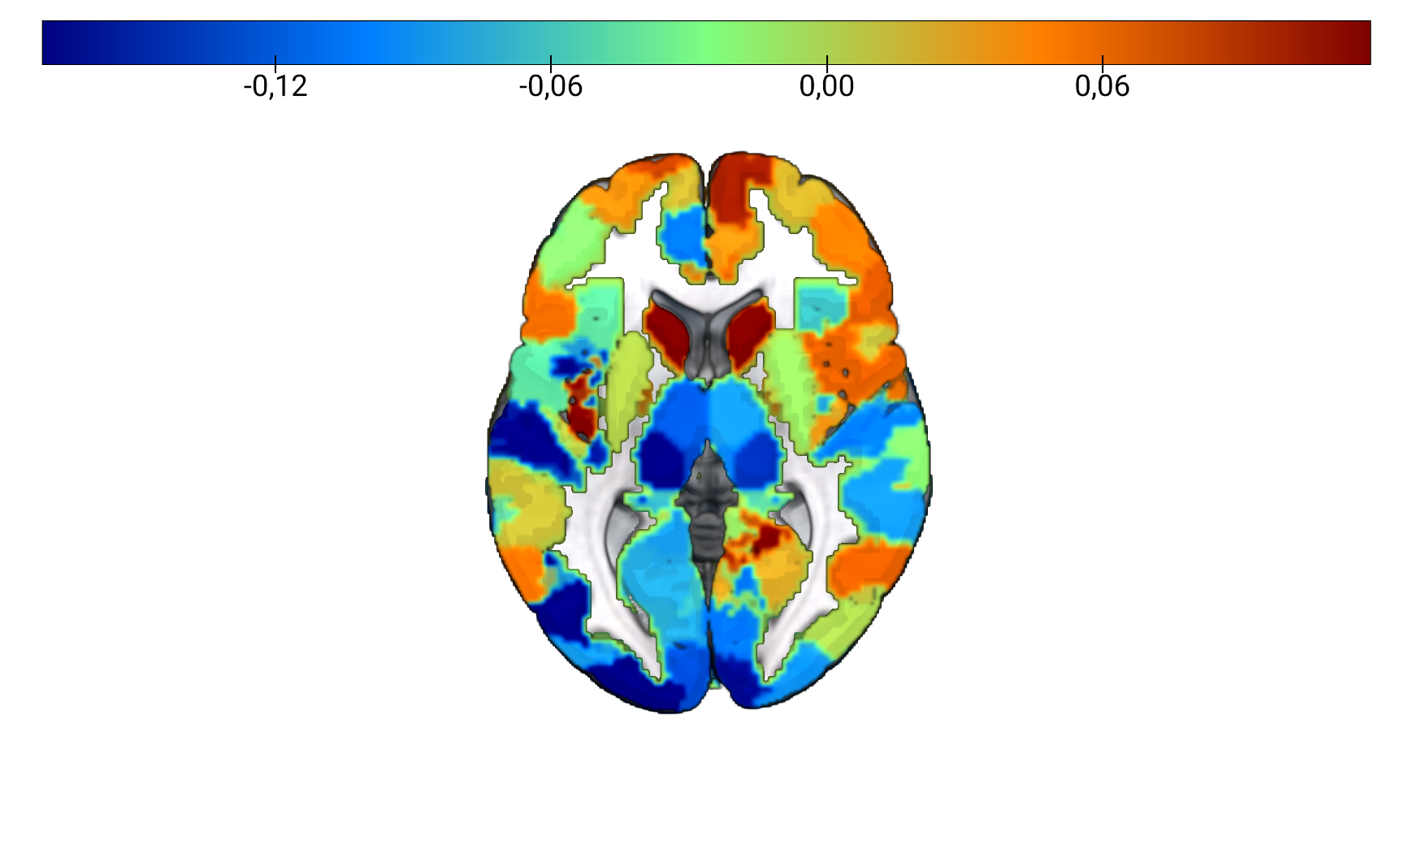
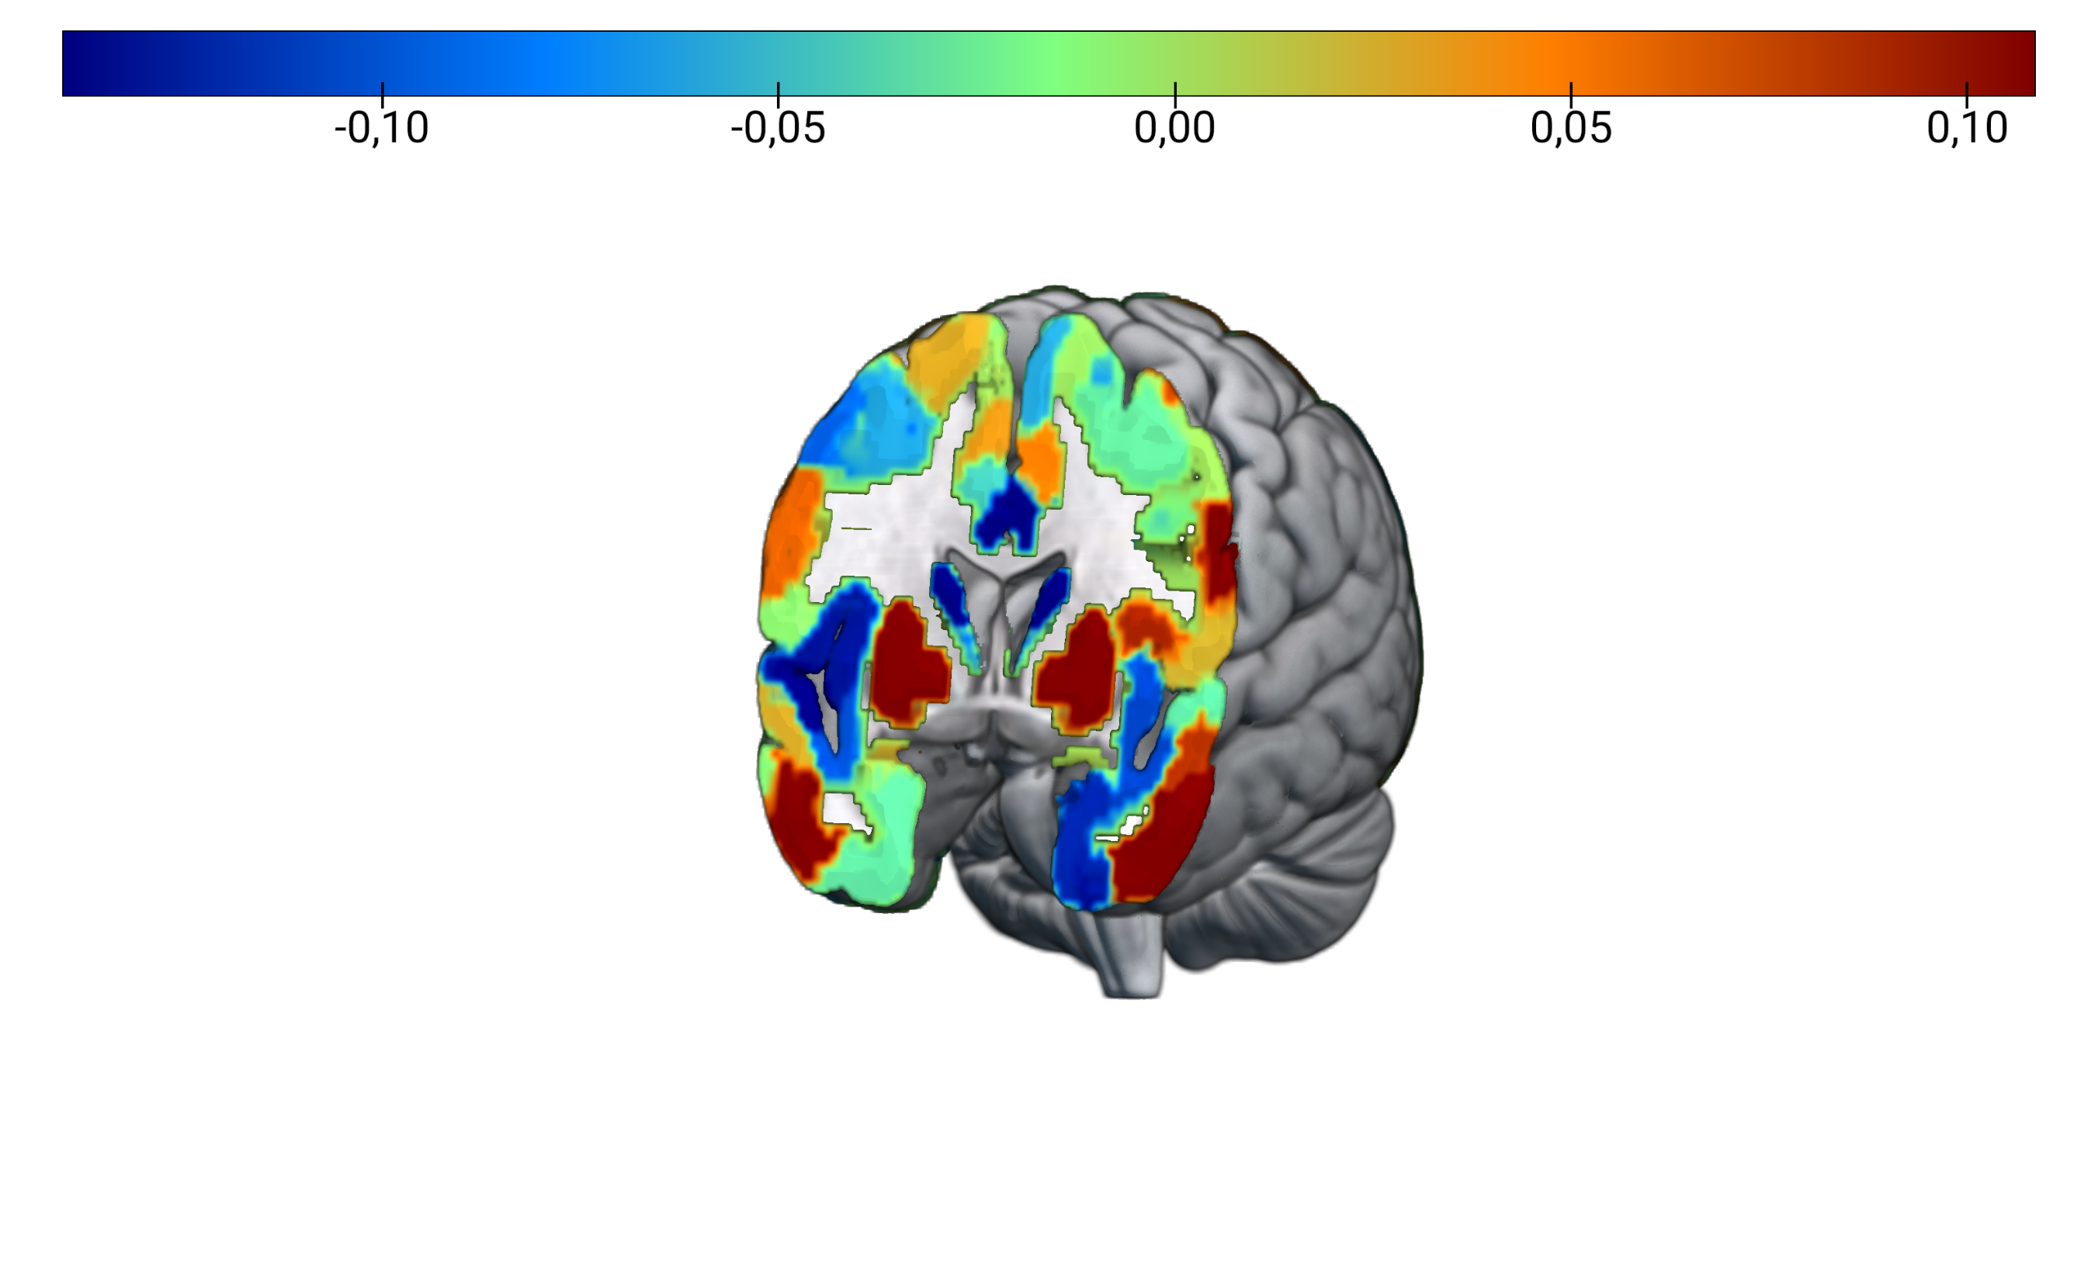
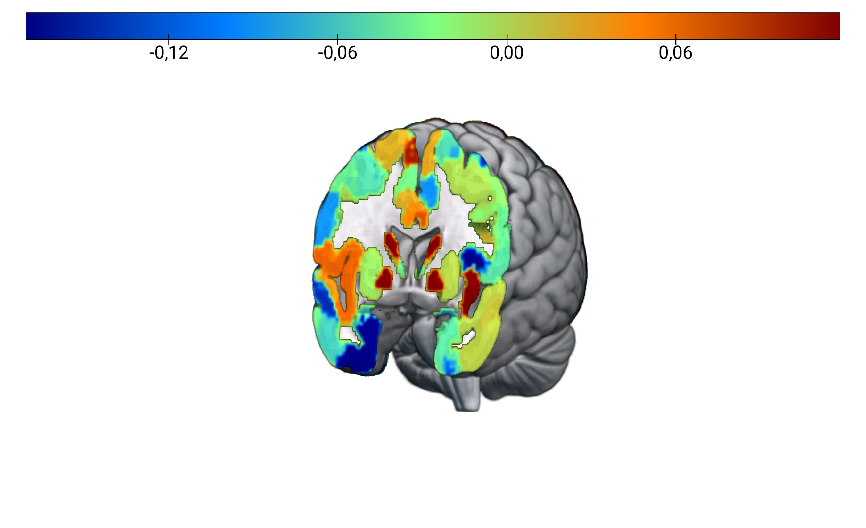
Brain Regions for Prediction of Brain Age are Different between FDG-PET and MRI
FDG-PET
MRI
(A)
(B)
Figure 2. Feature importance for brain age prediction. (A) Average weights of support vector regression across three models for brain age prediction using FDG-PET. Two out of the five train test splits required a non-linear kernel for optimal prediction of brain age. Weights were highly correlated across models (r > 0.8). (B) Average weights of support vector regression across all five models for brain age prediction using MRI. Weights were highly correlated across models (r > 0.8).
Notes:
PERMUTATION IMPORTANCE FOR NON-LINEAR KERNELS?

Slide 11
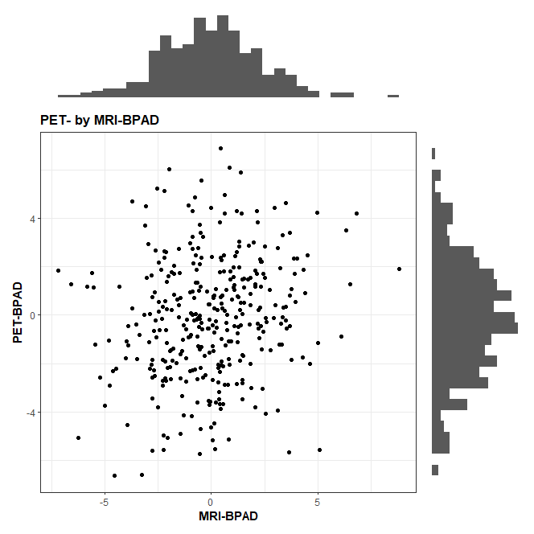
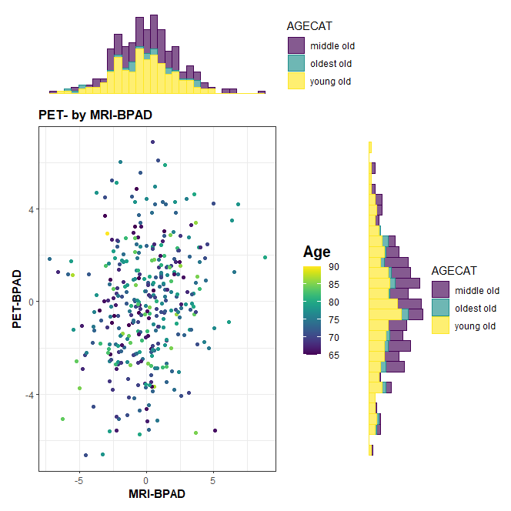
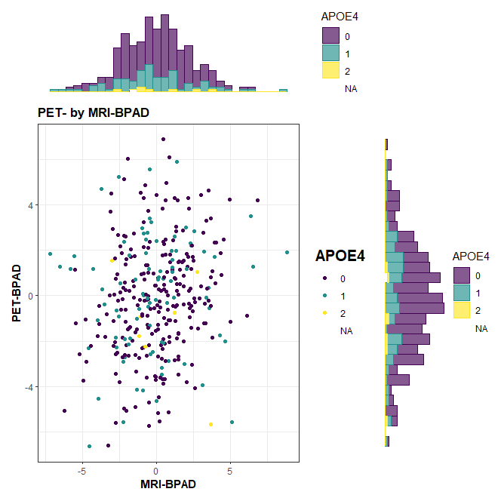
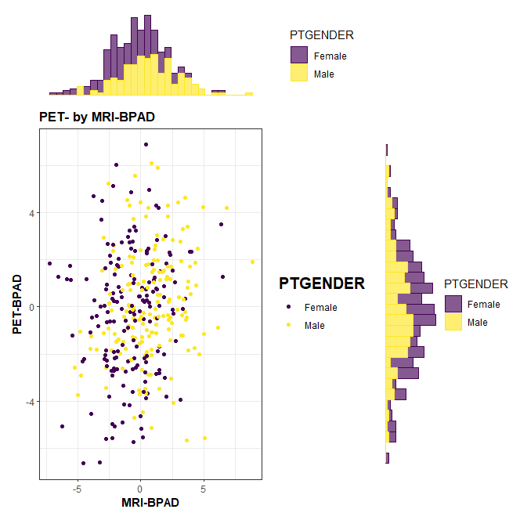
FDG-PET- and MRI-BPAD are weakly correlated
r = 0.173, p < 0.01
Sex
Notes:
Distribution plot
T-test between BPAD in female/male

Slide 12
Association of BPAD with Cognitive Function, Neuropathology, and Cognitive Decline
Cognitive Function (CF):
Neuropathology (NP):
Cognitive Decline (CD): Diagnosis after 24 months
ADNI-MEM, ADNI-EF
Pearson/Spearman Correlations between BPAD and CF/NP
Partial correlations between BPAD and CF/NP controlling for age and sex
- CSF Aβ, PET amyloid (global AV45), - CSF Tau, CSF Ptau, PET tau (AV1451 meta-ROI)
Logistic Regression to predict CD from BPAD, age and sex
Notes:
To assess the association of BPAD with cognitive function, we calculated correlations between BPAD and ADNI memory and executive function scores.
The association of BPAD and neuropathology was assessed through correlations between BPAD and CSF or PET amyloid or tau measures
Finally, we used logistic regression to predict individuals’ diagnosis in 24 months from BPAD, age and sex.

Slide 13

BPAD in CN
Notes:
Now I proceed to showing you results of associations of BPAD with cognitive function, neuropathology and cognitive decline in cognitively normal individuals.

Slide 14
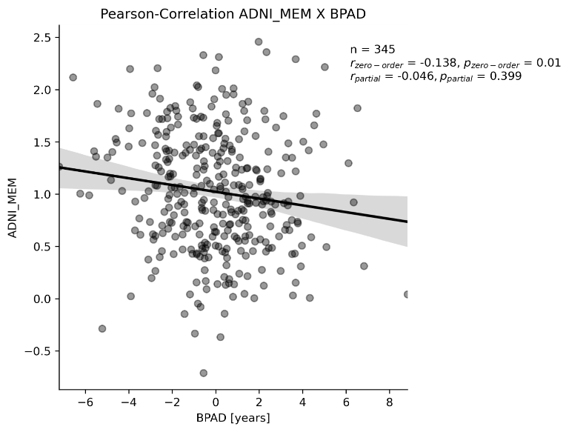
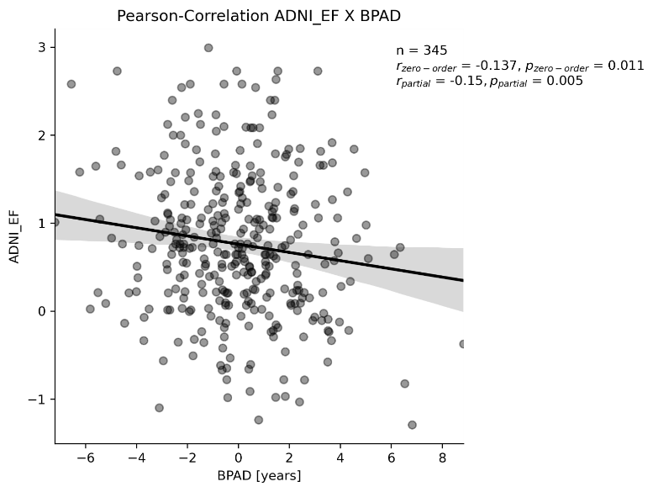
Higher MRI-BPAD is associated with worse cognitive performance in CN
Memory Executive Function
n = 345
r = -0.138**
Not correlated after correction for age and sex
n = 345
r = -0.137**
r_{partial} = -0.150**
* Significant at p < 0.05, ** significant after Bonferroni correction
Notes:
We found that higher MRI- but not FDG-BPAD was associated with worse cognitive performance in cognitively normal individuals. In these graphs here, we can see that both memory and executive function decline as BPAD rises, although only the decline in executive function withstands correction for age and sex in these correlations.

Slide 15
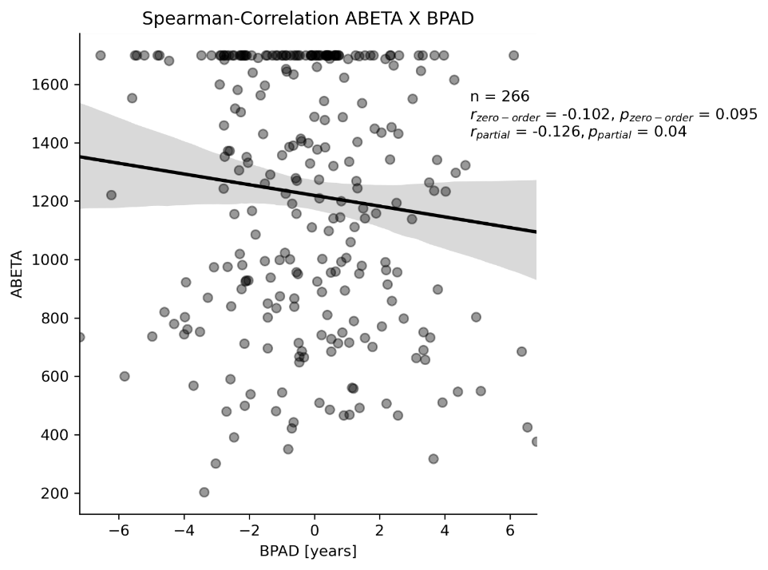
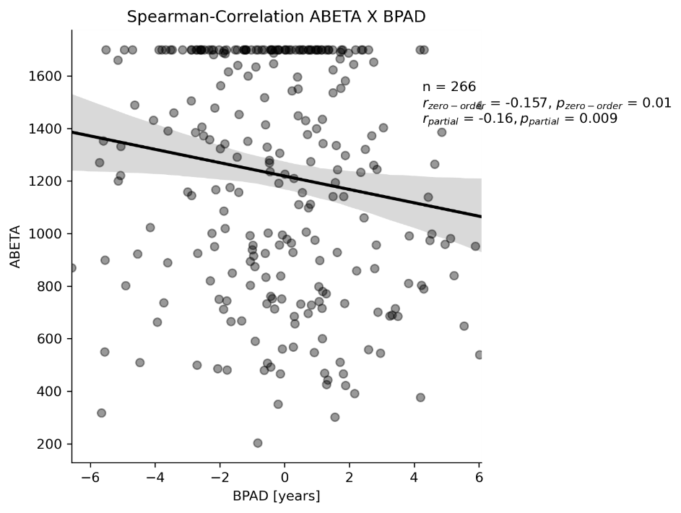
Higher BPAD (esp. FDG) is associated with lower CSF Aβ levels
CSF Aβ
CSF Aβ
n = 266
Not significant without correction for age and sex
ρ_{partial} = -0.126*
n = 266
ρ = -0.157*
ρ_{partial} = -0.160**
* Significant at p < 0.05, ** significant after Bonferroni correction
Notes:
In terms of neuropathology in cognitively normal individuals, however, we found more significant associations between FDG-PET and CSF amyloid beta. MRI BPAD correlations did not survive Bonferroni correction.

Slide 16
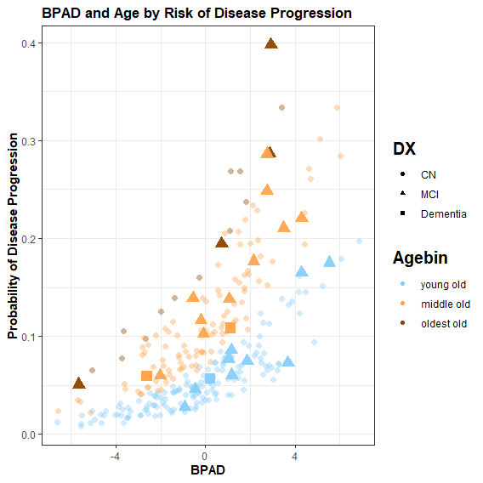
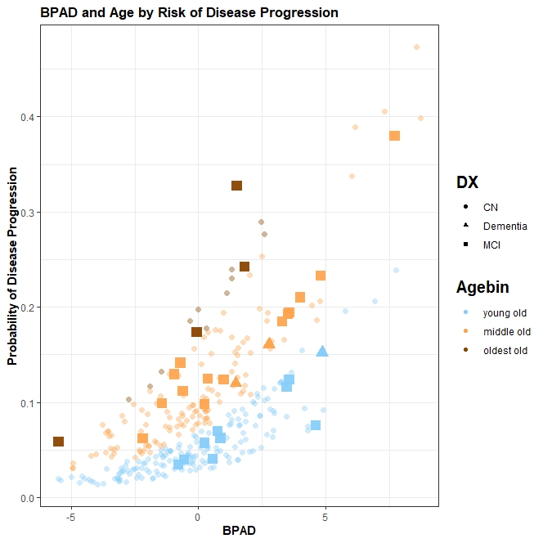
FDG-BPAD predicts conversion to MCI/Alzheimer’s disease in CN
27% increased odds to develop (mild) cognitive impairment within two years per one year BPAD (95%CI [7%, 51%])
age: OR = 10% (95%CI [3%, 19%])**, sex not significant in logistic regression
negative BPAD
Total: 153
Converters: 8 (5%)
positive BPAD
Total: 142
Converters: 18 (13%)
27%
**
.
Diagnosis after 24 months
CN (n=305)
MCI (n=23)
AD (n=3)
Age Category
Young old (<75 y.)
Middle old (75 – 84 y.)
Oldest old (> 85 y.)
* Significant at p < 0.05, ** p < 0.01, *** p < 0.001
0
Notes:
Finally, a diagnosis of MCI or Alzheimers disease two years after the scans were taken was significantly predicted from FDG BPAD. We found that the odds of someone converting to an MCI/AD diagnosis within two years are increased by 27% for every additional year in BPAD. The graph on the right shows individuals’ BPAD plotted against der predicted probability of disease progression. We see that both increasing BPAD, the position on the x-axis, and increasing age, the colors, contribute to a higher probability of conversion.
MRI BPAD did not significantly predict a person’s diagnosis in two years.

Slide 17
BPAD in MCI
Notes:
Now I proceed to showing you results of associations of BPAD with cognitive function, neuropathology and cognitive decline in patients diagnosed with mild cognitive impairment.

Slide 18
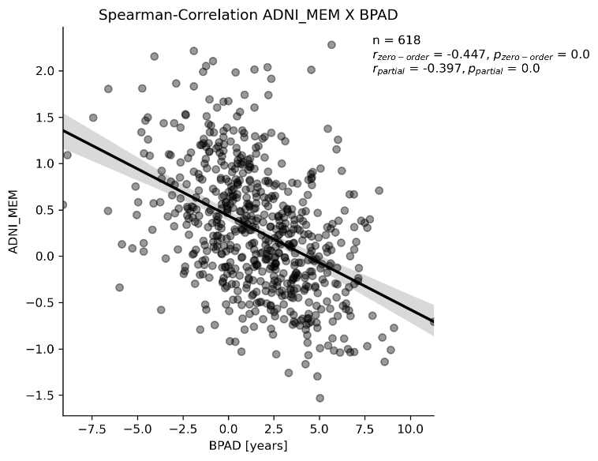
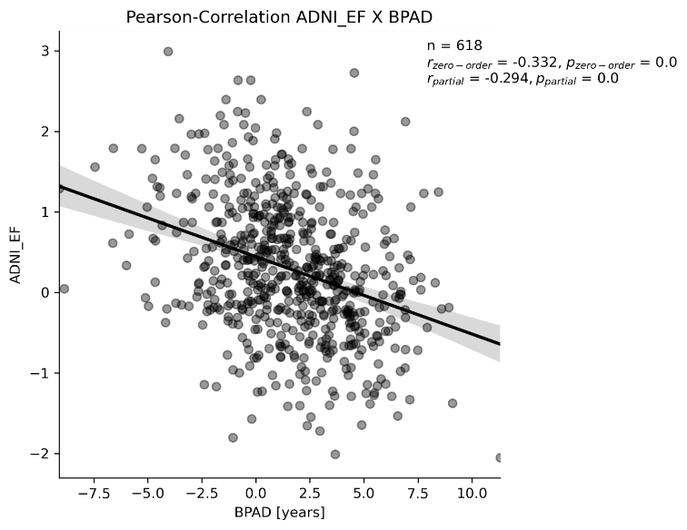
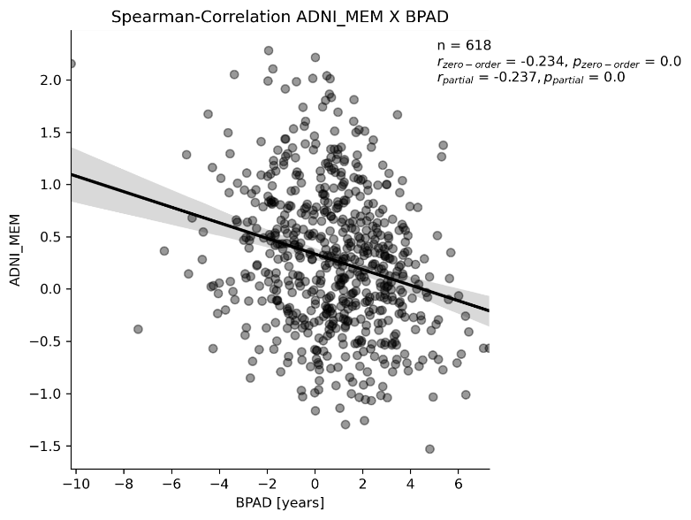
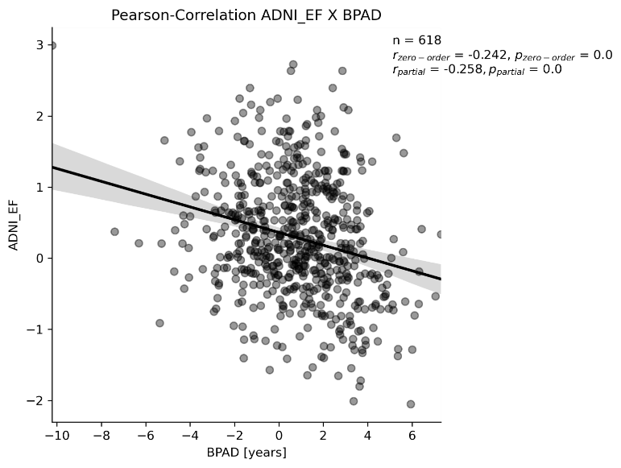
Higher BPAD (esp. MRI) is associated with worse cognitive performance in MCI
Memory Executive Function
Memory Executive Function
n = 618
r = -0.332**
r_{partial} = -0.294**
n = 618
ρ = -0.447**
ρ_{partial} = -0.397**
n = 618
r = -0.332**
r_{partial} = -0.294**
n = 618
ρ = -0.234**
ρ_{partial} = -0.237**
n = 618
r = -0.242**
r_{partial} = -0.258**
* Significant at p < 0.05, ** significant after Bonferroni correction
Notes:
Higher BPAD in both modalities is associated with worse memory and executive function scores. All correlations were significant with and without correction for age and sex and withstood Bonferroni correction. A Fisher transformation of the correlation coefficients revealed that memory decline was associated more strongly with MRI-BPAD as compred to FDG-BPAD, while no significant difference was found for the decline in executive function.

Slide 19
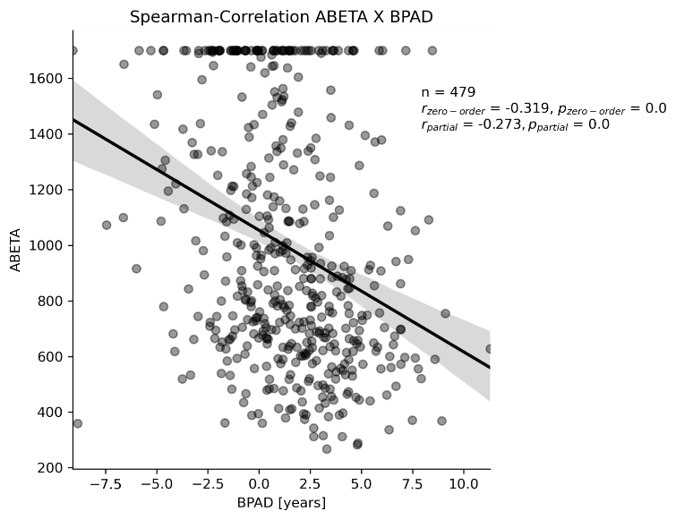
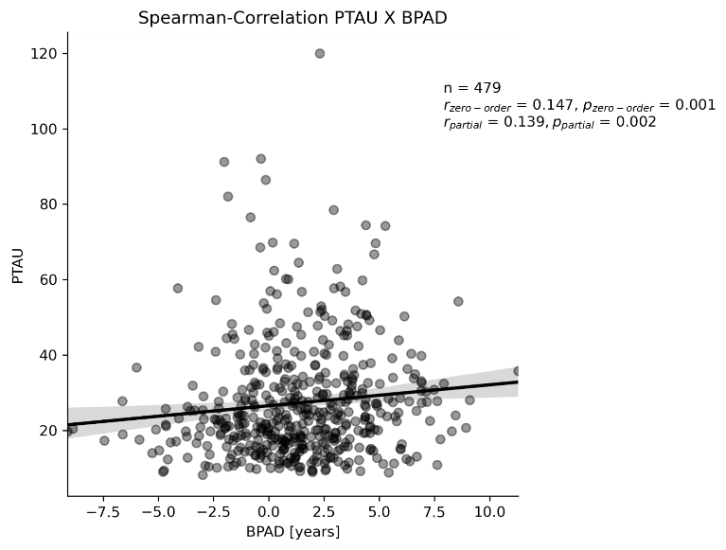
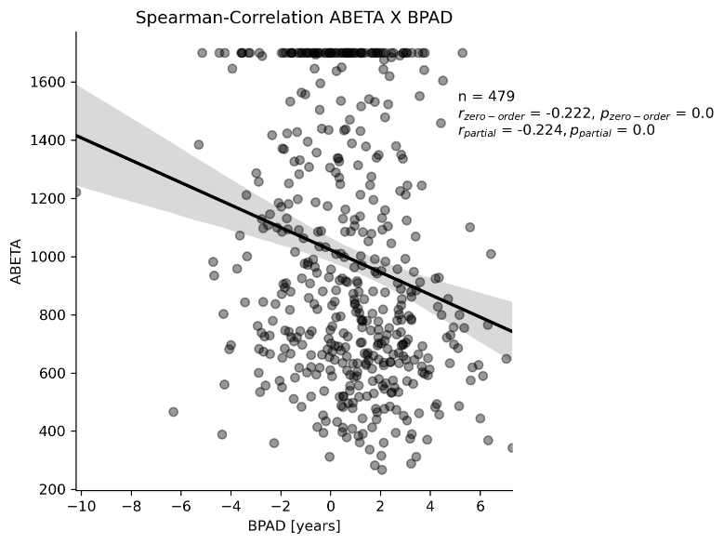
Higher BPAD (esp. MRI) is associated with more neuropathology in MCI
Amyloid PTau
Amyloid Tau/PTau
n = 479
ρ = -0.319**
ρ_{partial} = -0.273**
n = 479
ρ = 0.147**
ρ_{partial} = 0.139**
n = 479
ρ = -0.222**
ρ_{partial} = -0.224**
* Significant at p < 0.05, ** significant after Bonferroni correction
Notes:
Especially MRI-BPAD was also associated with enhanced neuropathology in terms of CSF and PET amyloid, as well as CSF tau and phosphorylated tau. FDG-PET was associated comparably strong with amyloid, however there were no correlations with measures of tau in patients with mild cognitive impairment.

Slide 20
Across Models…
Stronger and more significant correlations with neuropathology/cognitive function using MRI-BPAD.
Table 3. Correlation strength (rho or r) between BPAD and neuropathology/cognitive function across five different models
 | FDG-PET |  | MRI
 | Zero-order | Partial | Zero-order | Partial
CSF ABETA | -0.222 [-0.237; -0.172] | -0.186 [-0.224; -0.135] | -0.316 [-0.319; 0.305] | -0.269 [-0.279; -0.266]
AV45 (global SUVR) | 0.137 [0.113; 0.154] | -- | 0.197 [0.176; 0.217] | 0.173 [0.163; 0.202]
CSF Tau | -- | -- | 0.127 [0.121; 0.138] | 0.124 [0.114; 0.138]
CSF PTau | -- | -- | 0.146 [0.141; 0.157] | 0.139 [0.131; 0.153]
ADNI-MEM | -0.279 [-0.321; -0.234] | -0.250 [-0.257; -0.234] | -0.455 [-0.459; -0.443] | -0.409 [-0.420; -0.397]
ADNI-EF | -0.272 [-0.323; -0.241]* | -0.255 [-0.258; -0.219]* | -0.325 [-0.339; -0.307]* | -0.290 [-0.301; -0.286]*
Notes. Median [range] of correlation coefficients are displayed when significant (p<0.05) correlation existed in brain-predicted age according to all five models. Coefficients are Spearman Rho unless marked by an asterisk (*: Pearson’s r coefficient).
A table of all correlation coefficients and their p values will go into the supplementary materials.

Slide 21
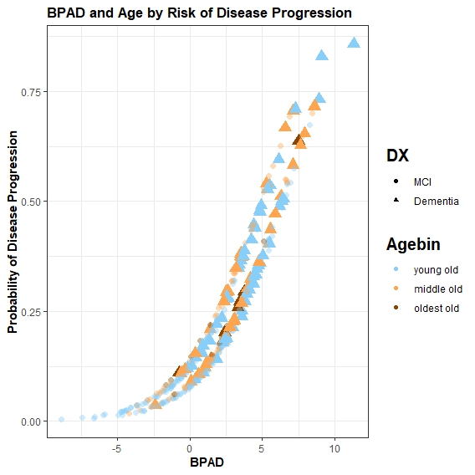
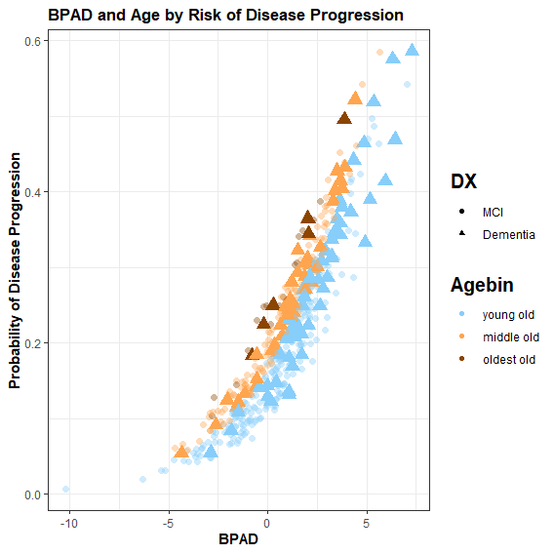
Higher BPAD (esp. MRI) predicts conversion to Alzheimer’s disease in MCI
.
negative BPAD
Total: 131
Converters: 5 (4%)
negative BPAD
Total: 159
Converters: 16 (10%)
46%
***
36%
***
increased odds per 1 year BPAD to develop AD within 2 years
increased odds per 1 year BPAD to develop AD within 2 years
positive BPAD
Total: 331
Converters: 95 (29%)
positive BPAD
Total: 303
Converters: 84 (28%)
0
0
MCI (n=362) AD (n=100)
* Significant at p < 0.05, ** p < 0.01, *** p < 0.001
Diagnosis after 24 months
Age Category
<75 y. 75 – 84 y. > 85 y.
Notes:
Finally, a diagnosis of Alzheimers disease two years after the scans were taken was significantly predicted from BPAD in both modalities. From these two graphs showing the probability of progression to Alzheimer’s disease by BPAD and age, we can appreciate that especially in MRI, the fitted logistic regression makes use of BPAD to predict the development of Alzheimer’s disease. If we compare the numbers of individuals converting to Alzheimer’s disease in negative and positive BPAD, we find that only a minority of individuals with a negative MRI-BPAD convert to AD, while a considerable 29% with a positive BPAD will convert to AD. This distinction appears less clear on the right-hand side, where results for FDG-PET are portrayed. For both modalities, the odds of developing Alzheimer’s disease within the next two years increase by a considerable percentage per one year BPAD, almost 50% for MRI-BPAD!

Slide 22
Across Models…
Stronger and more significant increase of odds of conversion using MRI-BPAD.
Table 4. Odds ratio to develop Alzheimer’s disease within two years with a baseline diagnosis of MCI across five models.
 | FDG-PET | MRI
BPAD | 32% [16%; 36%] | 46% [44%; 53%]
Sex | -- | -41 [-40%; -42%]
Age | -- | --
Notes. Median [Range] percentage increase is displayed per one year increase in BPAD or if sex = Male. Sex was a significant predictor in 0/5 models in FDG-PET and 3/5 models in MRI. Age was a significant predictor in 1/5 models in FDG-PET and 0/5 models in MRI.
A table of all p-values of the logistic regression, ORs and their 95% CI will go into the supplementary materials.
Notes:
XX what are 95% CI, how do you calculate it

Slide 23
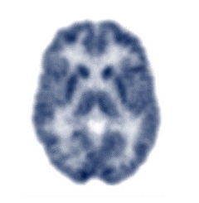
And the winner is…
Brain age can be predicted comparably well from FDG-PET or MRI, but…
Cognitive Performance
AD Neuropathology
Disease Progression
CN
FDG-PET-predicted age better captures early disease-related neuropathology and risk.
Onset of tau-related neurodegeneration and of objective cognitive decline is more strongly associated with signals of increasing brain age on MRI.
MCI
Notes:
So now let’s wrap it up.
We found that brain age can be predicted comparably well from FDG-PET or MRI, however
READ

Slide 24
Discussion Points
First study to consider use of different modalities for brain age prediction depending on disease stage
Stratified train-test splitting allowed to test for associations in large set of CN test predictions
FDG as early, MRI as later biomarker of neurodegeneration is consistent with existing literature
Discuss differences in FDG-PET and MRI
MRI more sensitive to sex differences?

Slide 25

Limitations
Use of 6*IQR uncommon → use as automatic outlier exclusion that only excludes severely abnormal scans
…

